Slide 1
Time-Sensitive Deep Learning for ICU Outcome Prediction Without Variable Selection or Cleaning
Jacob Deasy^{1,2}, Pietro Liò², and Ari Ercole³
¹correspondence: jd645@cam.ac.uk
²Computer Laboratory, University of Cambridge
³Department of Medicine, University of Cambridge
Notes:
PhD in the Department of Computer Science, Cambridge
Funded by the Medical Research Council – Data science and AI track
Co-supervised by Pietro Liò in Computational Biology and AI group + Ari Ercole in the Division of Anaethesia and the department of Medicine

Slide 2
Background
Extensive monitoring in the ICU generates large quantities of data.
Data contains interactions which are difficult to systematically evaluate.
In principle, computers to do not suffer this limitation.
However, current computational approaches:
Discard data
Require variable selection
Require variable cleaning
Our models avoids all of this and predicts early risk of mortality.
Notes:
More data in ICU than elsewhere in the hospital
”Certain machine learning algorithms have been purpose built to deal with long sequences of data”

Slide 3
Challenges of EHR/ICU datasets
Missing data
Irregular sampling
Erroneous readings
Clinician mistake
Faulty machine
Highly diverse data
Continuous wave forms
Discrete categories chosen by clinician (e.g. GCS)
High variability between patients
Notes:
More data in ICU than elsewhere in the hospital
”Certain machine learning algorithms have been purpose built to deal with long sequences of data”

Slide 4
Dataset: MIMIC-III
Contains data for 46,476 patients with 61,532 stays.
Demographics, vital sign time-series, laboratory tests, medications and procedures, fluid intake and outputs, clinician notes, and diagnostic coding.
Median age of adult patients is 65.8 (Q₁-Q₃: 52.8-77.8.).
55.9% patients are male
In-hospital mortality is 11.5%
330,712,483 chart events, 27,854,055 lab events and 4,349,218 output events = 13,233 unique variables.

Slide 5
Methods (1/2)
Embed medical concepts in the same way Natural Language Processing (NLP) embeds large word vocabularies.
Discretise continuous variables.
Map all variables to trainable vectors.
Learnt weights to aggregated hourly variables.
Model uses a medical vocabulary of: 13,233 unique variables.

Slide 6
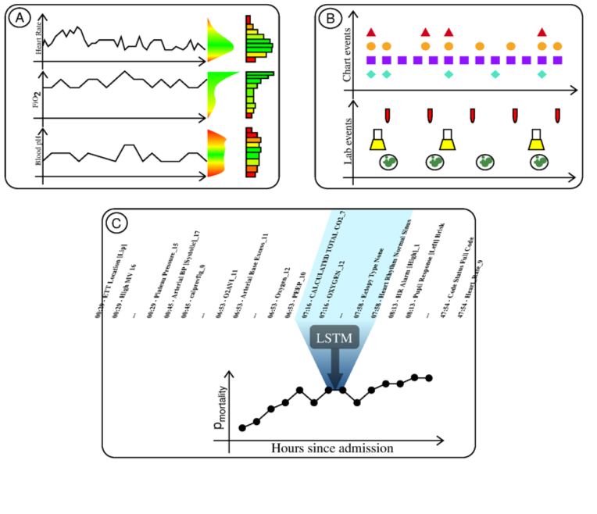
Methods (2/2)
Hourly aggregated embeddings used as input for a recurrent neural network.
Risk of mortality updated hourly using all variables.
Train model to minimise binary cross entropy.
Penalise misclassification of death or survival.

Slide 7
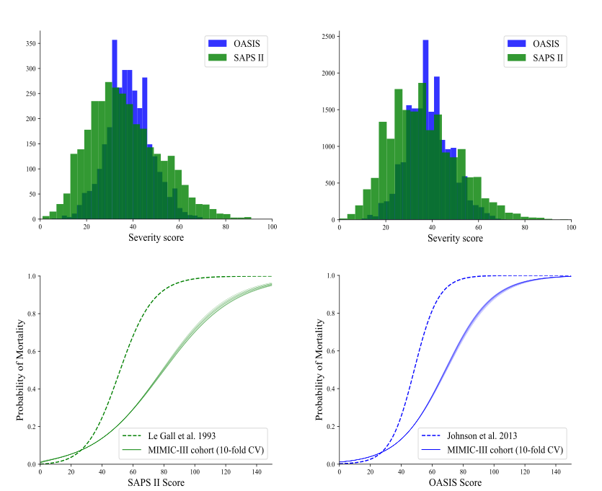
Results (1/2)
Tuned SAPS II and OASIS scores for comparison.
SAPS II:
12 routine measurements + previous health + admission info.
OASIS:
10 physiological measurements.
Train and test sets consistent.
10-fold cross-validation used.

Slide 8
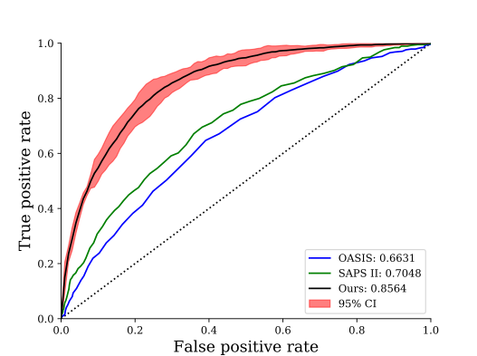
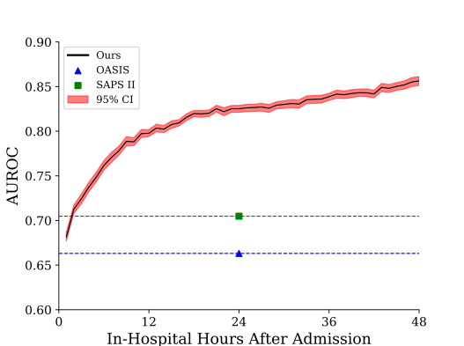
Results (2/2)
OASIS - 0.663 AUROC at 24 hours.
SAPS II - 0.705 AUROC at 24 hours.
Ours - 0.714 AUROC at 2 hours.
Ours - 0.811 AUROC at 12 hours.
Ours - 0.878 AUROC at 48 hours.

Slide 9
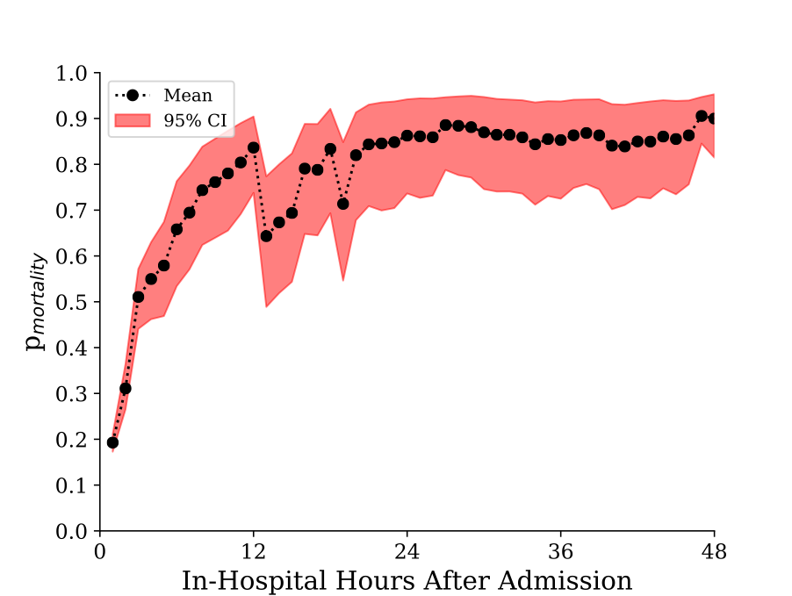
Interpretation: a case study
Hour 1 (top readings out of 38):
High diastolic blood pressure
Repeated elevated respiratory rate
Hour 3 (top readings out of 76):
Repeated low temperature
Low oxygen saturation
Surprisingly important general factors:
Code status for CPR instructions
Assigning consent to next of kin
Visitation by the priest

Slide 10
Summary and conclusions
Model using of over 13,000 clinical variables.
Dynamic prediction.
Performance exceeding SAPS II after 2 hours.
Confidence intervals to estimate uncertainty.
Flexible deep learning models can avoid:
Pre-processing, variable selection and variable cleaning
Clinicians can analyse model outputs, rather than model inputs.

Slide 11
Thank you for listening
Full paper describing our results:
https://arxiv.org/abs/1909.07214
Follow up research on variation of the aggregation methods:
https://arxiv.org/abs/1909.08981
Jacob Deasy^{1,2}, Pietro Liò², and Ari Ercole³
¹correspondence: jd645@cam.ac.uk
²Computer Laboratory, University of Cambridge
³Department of Medicine, University of Cambridge

